Slide 1
Microsoft Project 2007
Tracking Progress on Tasks

Slide 2

Course Objective
Track the progress of a project
  Project baseline
  Updating & Tracking the project
Track the progress of tasks
  Entering percentage completion
  Entering actual values

Slide 3


The Project Baseline
A project baseline is a snapshot of project plan
  Snapshot is created by saves values related to time, cost and work at the time of baseline
  The snapshot is used to compare scheduled values with actual values
  You must save a baseline before recording actual values. It is a must to track the project performance
You can save 10 interim baselines in Project 2007
  Following values are saved on saving a baseline
      Task Start and Finish dates
      Assignment Start and Finish dates
      Duration of a task
      Work required for a task
      Work assigned to a resource
      Times phased work for tasks and resources
      Cost of a task
      Cost of a resource
      Time phased cost for tasks and resources

Slide 4
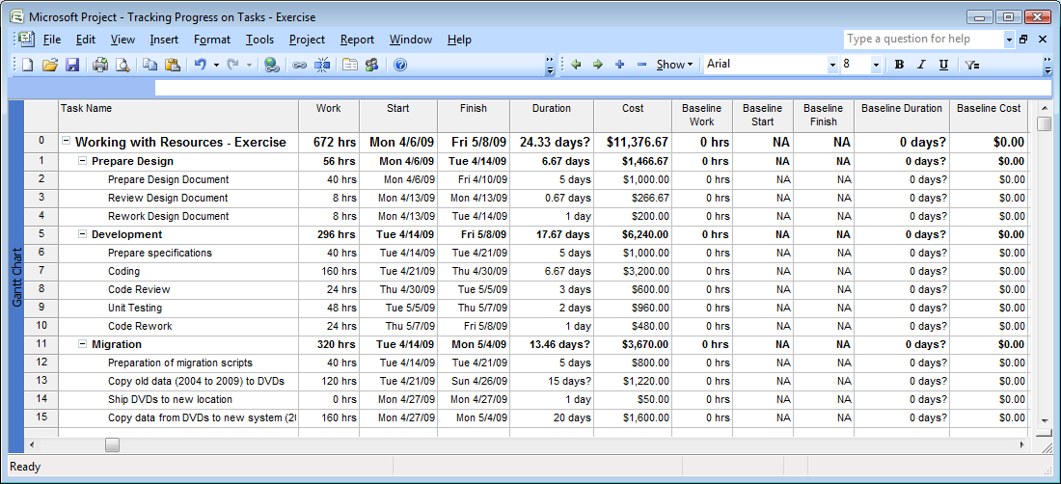
Saving a Project Baseline

Slide 5
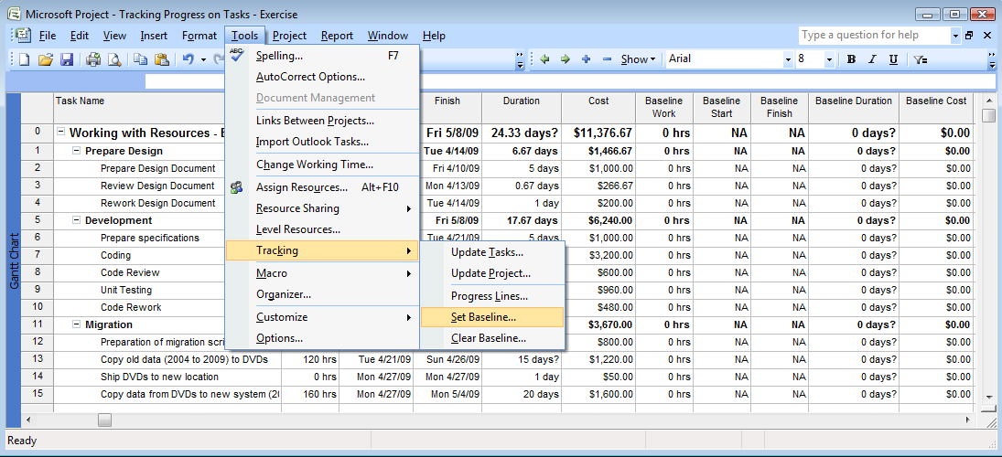
Saving a Project Baseline

Slide 6
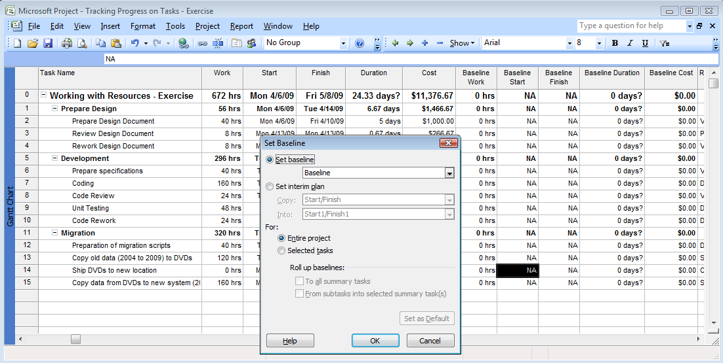
Saving a Project Baseline

Slide 7
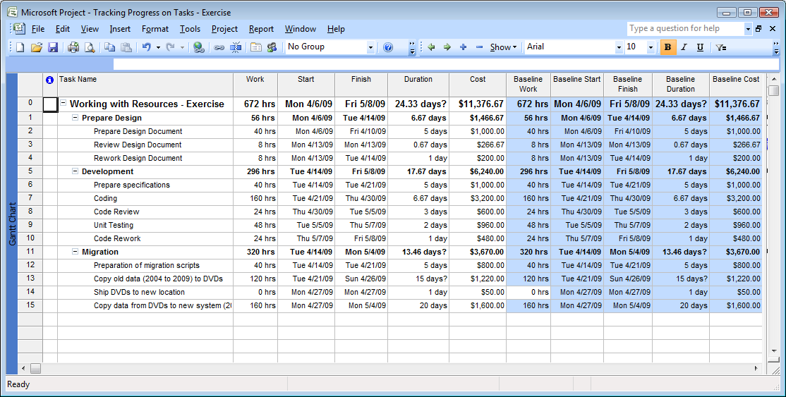
Saving a Project Baseline

Slide 8
Updating the Project
Update work at project level as complete through
Update percentage complete of individual tasks
Update actual work done for individual tasks
Updating work done by resource on individual tasks day by day

Slide 9
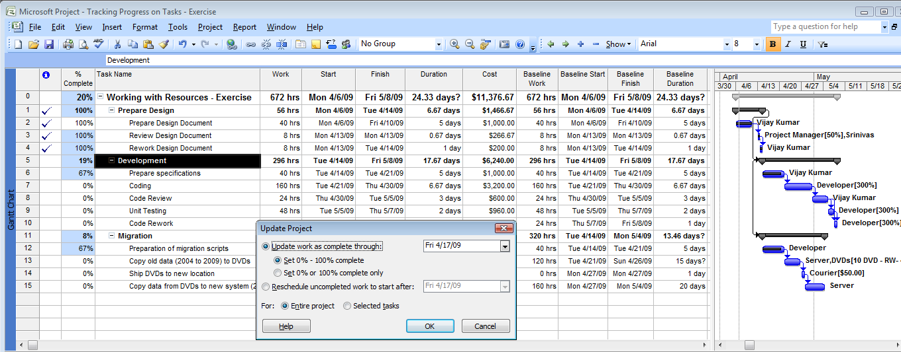
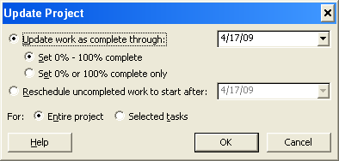
Updating the Project
Tools → Tracking → Update Project

Slide 10
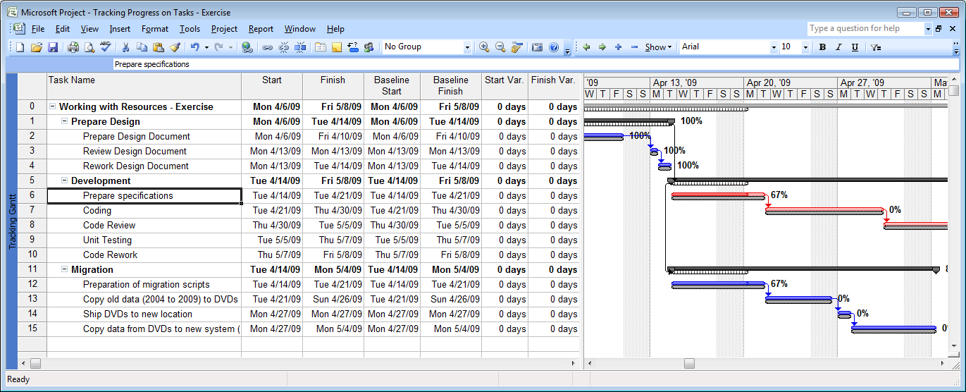
Tracking the Project
View → Tracking Gantt/Table: Variance

Slide 11

Questions
For which of the following tasks should you use the project baseline?
  To create a project plan
  To compare the amount of work done in the project
  To record the completion percentage of tasks
  To evaluate the project performance
  ✓
  ✓

Slide 12
Questions
To update the project schedule, you need to set a status date for the project. Using this date, you can record the completion percentage of all the tasks. Which of the following options should you use to set the status date for the project?
  Entire project option
  Set 0 percent or 100 percent complete only option
  Update work as complete through option
  Reschedule uncompleted work to start after option
  ✓

Slide 13
Course Objective
Track the progress of a project
  Project baseline
  Updating and Tracking the project
Track the progress of tasks
  Entering percentage completion
  Entering actual values

Slide 14
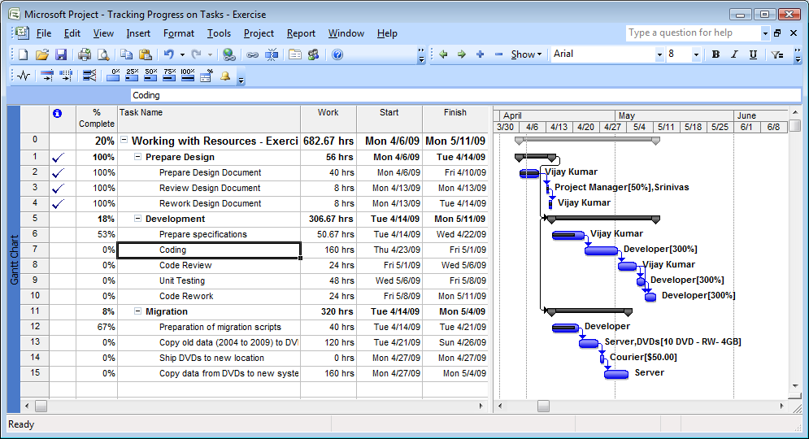
Specify the Completion Percentage for a Task
View → Toolbars → Tracking

Slide 15
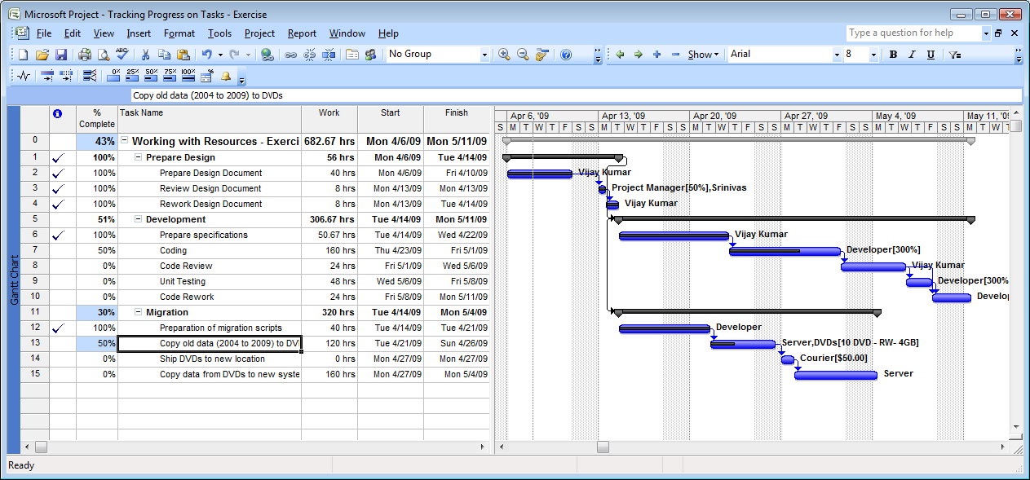
Specify the Completion Percentage for a Task

Slide 16
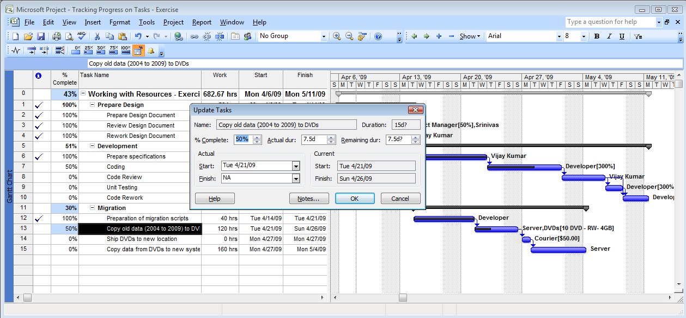
Specifying Actual Values for Tasks

Slide 17
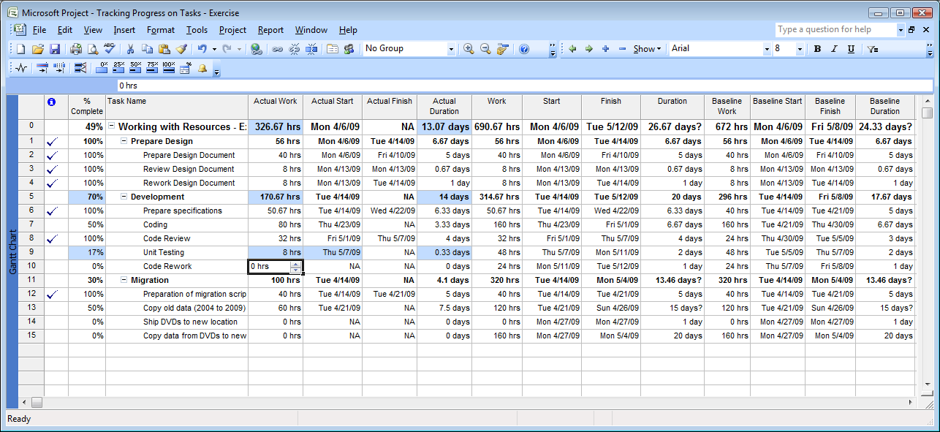
Specifying Actual Values for Tasks

Slide 18
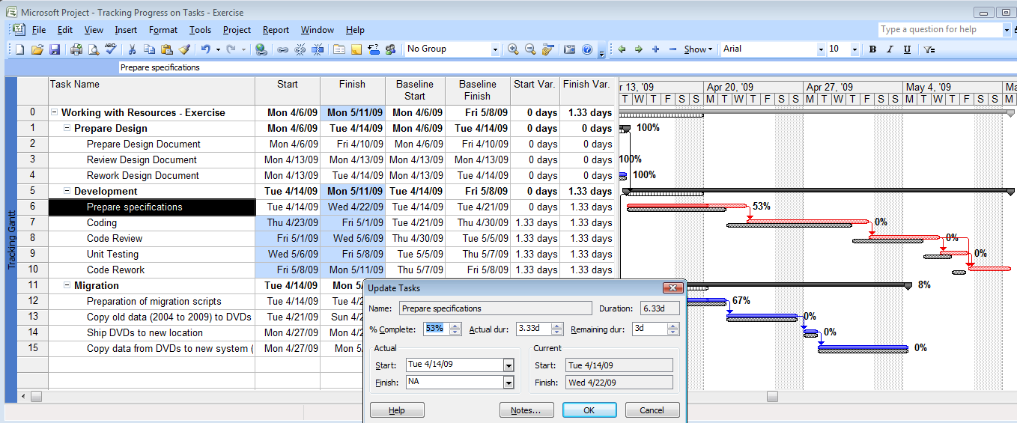
Specifying Actual Values for Tasks
Tools → Tracking → Update Tasks

Slide 19
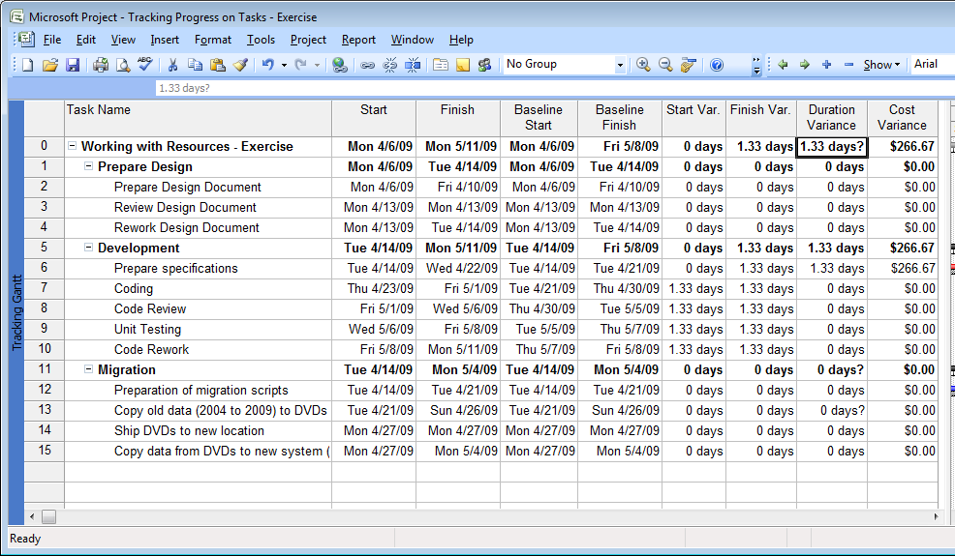
Tracking the Project

Slide 20
Exercise: Specifying Actual Values
Tasks | Work | Duration | Start | Finish | Status On 4/6/2009 | Status On 4/7/2009 | Status On 4/8/2009 | Status On 4/9/2009 | Resource
Task 1 | 24 hrs | 24 hrs | 4/6/2009 | 4/8/2009 | 50% | 100% |  |  | R1
Task 2 | 24 hrs | 24 hrs | 4/6/2009 | 4/8/2009 | 33% | 67% | 100% |  | R2
Task 3 | 24 hrs | 24 hrs | 4/6/2009 | 4/8/2009 | 33% | 55% | 75% | 100% | R3
Instructions:
  All resources are working 8 hours every – no less & no more
  If Task 1 is completed 50% on first day, it means 50% is completed in 8 hrs
  % Completion status is shown at the end of each day
  Specify actual values on each status date and observe the MSP behavior

Slide 21
Questions
You have been informed that due to the unavailability of some parts, the duration of some of your tasks has been affected. You need to update your project plan to calculate the impact on the actual duration of the successor tasks in your project. Which one of the following values should you update in your project plan to calculate the actual duration of successor tasks?
  Duration
  Scheduled start date
  Completion percentage
  Scheduled finish date
  ✓

Slide 22
Course Objective
Track the progress of a project
  Project baseline
  Track the project
Track the progress of tasks
  Entering percentage completion
  Entering actual values

